Slide 1
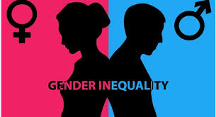
Gender Inequality
DEIDRE WHITTAKER
EXCELSIOR COLLEGE
ROBIN PARKS
6 JUL 2020

Slide 2
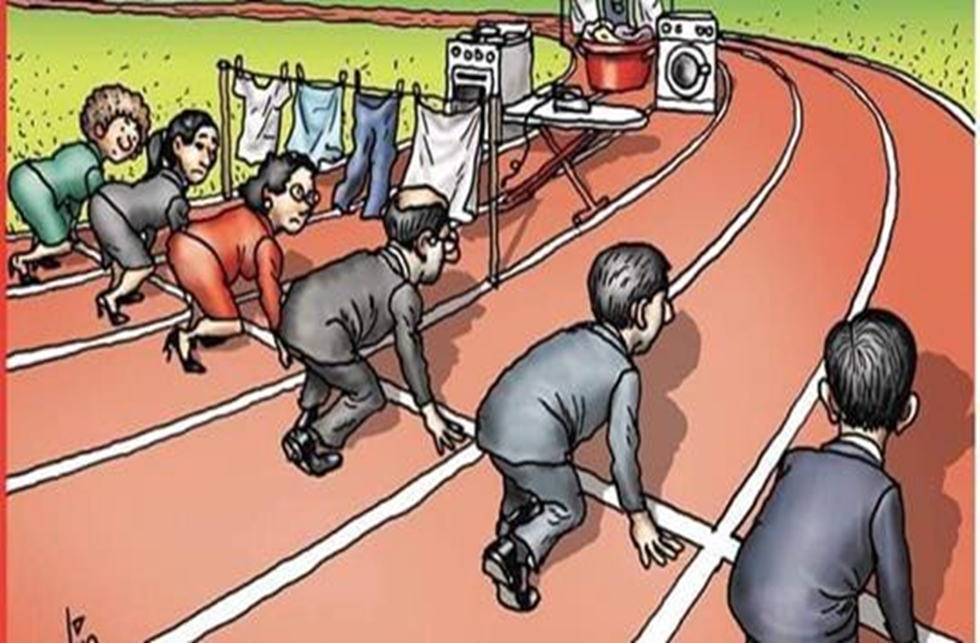
Gender Inequality
It is unfair or unequal treatment of a person based on their gender.
It is a global problem and challenges affects both developed and developing nations.
More women have reported become victims in the gender inequality as opposed to men.
The distinction evidenced in gender equality may be as a result of physiological, biological and social norms.
Some of the distinction may be socially constructed or empirically grounded.
Notes:
The act of treating persons unequally based on their gender is referred to as gender inequality. Gender inequality is a global problem and challenges affecting both developed and developing nations. According to the previous research, women have become victims of gender inequality instead of men, a situation that has raised concerns regarding protecting women's rights. The existing research has further confirmed that the distinction evidenced in gender equality may be a result of phycology, biology, and social norms. Notably, some of the differences may be socially constructed or empirically grounded.

Slide 3
Why is it my problem

Slide 4

Gender Inequality is My Problem Because
Societal members and mindset contributes significantly to promoting gender inequality.
Our organizations do not practice employment equality.
We emphasis more on job segregation
They have higher rates of antisocial behavior and violence in communities with gender inequality.
Gender Inequality impacts the nation’s economy and financial development adversely
Notes:
We, as the society members, have been confirmed as the primary contributor to gender biasness. According to Batra & Reio Jr. (2016), the organization that we work for or those that provide services to us do not practice gender equality, yet we do not run campaigns against the menace. Batra & Reio Jr. (2016) further enlightens that our CEO emphasizes job segregation, a practice that promotes gender inequality, and again we work quietly without complaining. Batra & Reio Jr (2016) provide that our communities are associated with racist-related instances, yet we do not run critics against its which would aid in reducing gender inequality amongst ourselves.

Slide 5
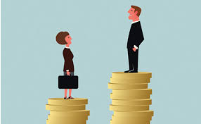
Effects of Gender Inequality
Leads to decreased job satisfaction and mental health among the victims.
Holds back the growth of individuals, societies and countries.
Unequal societies are less cohesive.
A less cohesive society does not promote sharing of information
Inequality

Slide 6
Examples of Gender Inequality

Slide 7
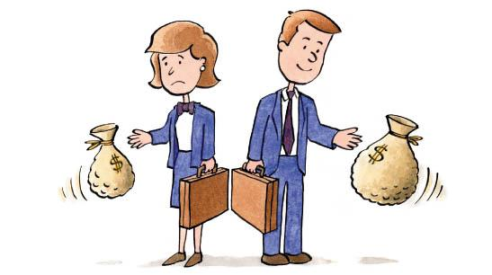
Examples Of Gender Inequality
Inequality in education opportunities
Inequality in earnings
Property ownership inequalities
Inequality in health access among the women
Political leadership inequalities
Discrimination at workplace
Biasness in job promotions
Gender based violence inequalities
Discrimination and biasness when raising a family
Family disputes inequalities
Notes:
There are a series of examples that can be used to elaborate on gender inequality vividly. Kleven, H., & Landais, C. (2017) describes the first example as discrimination at the workplace where gents are assigned to most senior tasks as opposed to their counterparts. Biasness during job promotions in organizations is yet another excellent example of gender inequality. Kleven & Landais (2017) further provide other shortcomings that come as a result of gender distinctions, including disparities in education opportunities, earnings, property ownership, healthcare access, and political activeness. Other forms of inequality include gender-based violence and family disputes.

Slide 8
Nature of Gender Inequality

Slide 9
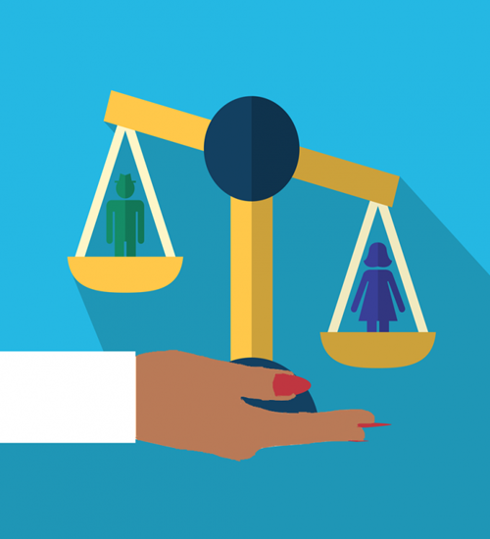
Nature Of Inequality Based On Culture
Women in some cultures are deemed inferior just by the nature of their gender
This is more evident among the African and the Asian communities
They are supposed to respect and take orders from the male gender
They cannot have a voice of their own
Notes:
The previous research has confirmed that women in some cultures are deemed inferior just by the nature of their gender. According to Huang, Gates, Sinatra & Barabási (2020), cases of gender inequality are more evident among African and Asian communities. Gates, Sinatra & Barabási (2020) further suggest that societies that practice gender inequality expect female counterparts to respect and take orders from the male gender, a situation that fuels feminism and racism. However, it is worth noting that the female cannot have a voice on their due much exposure to pressure.

Slide 10
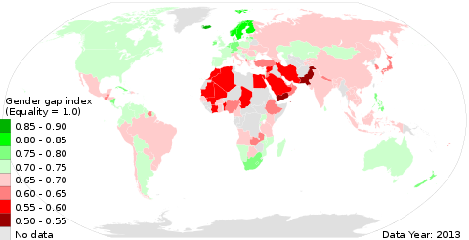
Workplace and Career
There are career that are deemed to be male oriented and women should not take such.
This has discouraged many women who may even do better than their male counterparts in the same field
This has led to a disparity even in the earnings for the female gender
Promotions among the women are very rare in these male dominant workplaces.
Notes:
Some careers are deemed to be male-oriented, and women should not take such jobs. Such discrimination in career has discouraged many women who may even do better than their male counterparts in the same field (Batra & Reio Jr. 2016). The authors suggest that career inequality has led to a disparity even in the earnings for the female gender. Importantly, promotions among women are rare at the workplace.

Slide 11
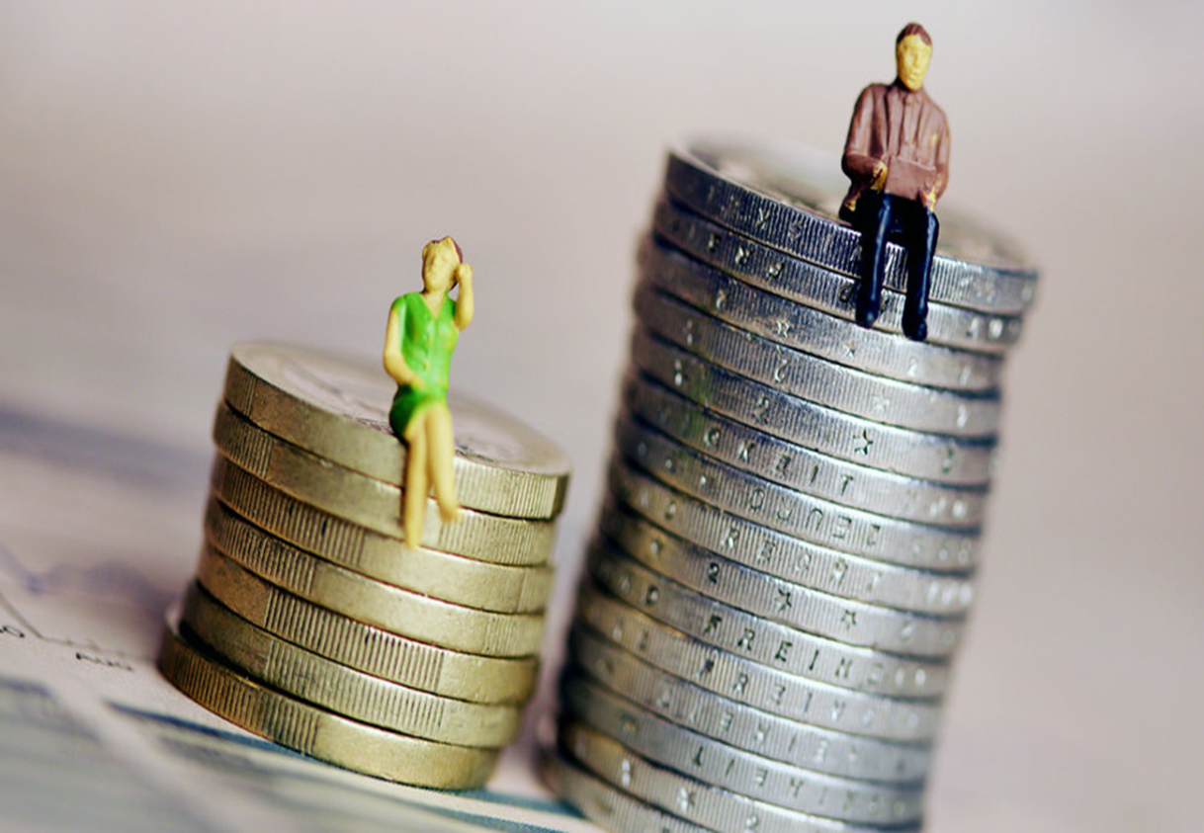
Workplace and Career
Some male gender still belief that women should not take leadership roles in the society just because they are female.
Women have been denied political leadership especially the elective positions because of such bias and inequality.
Notes:
Male gender still believes that women should not take leadership roles in society just because they are female (Batra & Reio Jr., 2016). Women have been denied political leadership, especially elective positions, because of such bias and inequality.

Slide 12
Solutions to Gender Inequality

Slide 13
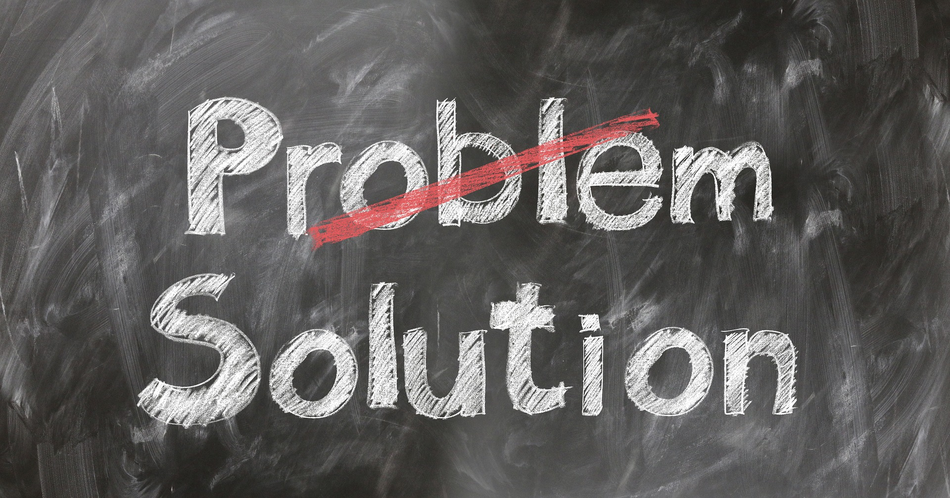
To solve to Gender Inequality We Need to:
Change society belief that male gender is superior to female gender.
Start schools that cater for the disparity in education and academics for the girl child.
Empower women in leadership by achieving the 3rd gender rule by UN.
Changing societal perception is the key in dismantling this menace of gender inequality.
Notes:
Various interventions can be utilized to eliminate gender inequality in society. First, we should change society's belief that the male gender is superior to the female gender. Again our leader should start schools that cater to the disparity in education and academics for the girl child. Community leaders should empower women in leadership by achieving the UN's 3rd gender rule (Kim, Lee & Shin, 2016). Importantly, family leaders should take emphasis on share household chores in addition to having laws that govern domestic violence.

Slide 14
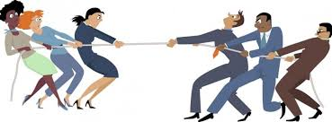
To solve to Gender Inequality We Need to:
Share household chores among family members.
Have and enforce the laws that govern against domestic violence.
Develop protocols for promotion at workplaces.
Pay salaries based on merit, qualifications and not based on gender.
Enforce zero tolerance on sexual harassments and racism.
Notes:
Kim, Lee & Shin, (2016) suggest that the government and organizations should develop protocols for promotion at workplaces and pay salaries based on work done and not based on wages. Zero tolerance on sexual harassments and racism should also be encouraged among employees

Slide 15
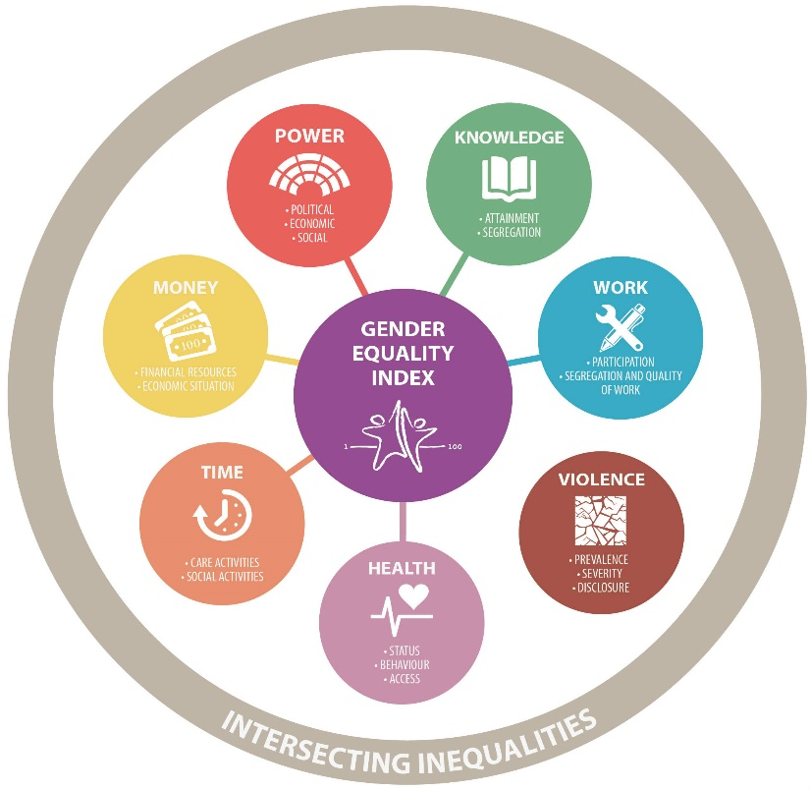
Conclusion

Slide 16
Conclusion
Despite the achievement and efforts made, a lot still needs to be done in order to achieve equality among the two genders.
Gender inequality data across the globe has proven the importance of having this discussion.
Women are still suffering even in the 21st century due to this inequalities based on their gender.
Gender equality helps stimulate economic growth, which is essential in low-income countries.
Overall gender equality is essential to making and keeping our communities safer and healthier.

Slide 17
Citations

Slide 18
References
Batra, R., & Reio Jr, T. G. (2016). Gender inequality issues in India. Advances in Developing Human Resources, 18(1), 88-101.
Blau, F. D. (2016). Gender, inequality, and wages. OUP Catalogue.
Heise, L., Greene, M. E., Opper, N., Stavropoulou, M., Harper, C., Nascimento, M., ... & Henry, S. (2019). Gender inequality and restrictive gender norms: framing the challenges to health. The Lancet, 393(10189), 2440-2454.
Huang, J., Gates, A. J., Sinatra, R., & Barabási, A. L. (2020). Historical comparison of gender inequality in scientific careers across countries and disciplines. Proceedings of the National Academy of Sciences, 117(9), 4609-4616.

Slide 19
References cont..
Kim, J., Lee, J. W., & Shin, K. (2016). A model of gender inequality and economic growth. Asian Development Bank Economics Working Paper Series, (475).
Kleven, H., & Landais, C. (2017). Gender inequality and economic development: fertility, education and norms. Economica, 84(334), 180-209.

